Slide 1
Self awareness

Slide 2
Task
In pairs, interview each other about your names:
Who gave you your name?
Does your name have a meaning?
Do you like/dislike your name?
Have you ever chosen to be called something different?
Have other people ever called you something different?

Slide 3
Class discussion
What does it feel like to be called names we don’t like?
Why is it wrong to make fun of people’s names?
What sort of things do people get called names about?
What can we do to stop name calling?

Slide 4
Self awareness definition
Identity is a way of describing who I am as an individual
Self awareness is knowing who I am in a deeper sense
This includes understanding:
My character, personality and feelings
Why I behave and react in particular ways
What is important to me and what motivates me

Slide 5
Task
In pairs, discuss:
If you were the person in the advert what would you want people to know about you?
What aspects make up your identity?
Who has played a part in shaping your identity so far in your life?
What events in your life have shaped your identity?

Slide 6
Identity circles exercise
Physical characteristics
What do you look like?
Goals and aspirations
What’s important to you? What are your future dreams?
Draw a picture of yourself in the middle circle and add your name
Important people or influences
in your life
Weaknesses
What are you struggling with, your challenges and improvements?
Strengths What are you good at? Include something you are proud of or pleased with

Slide 7
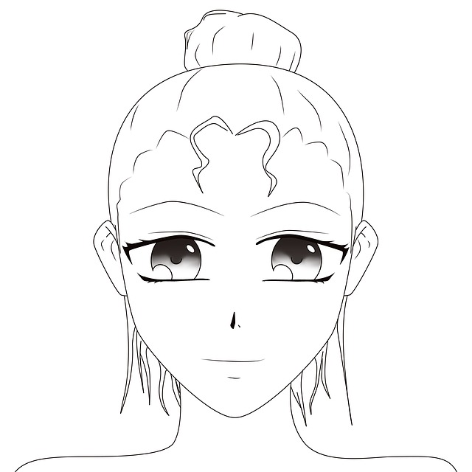
Identity circles exercise
Me
Blonde, hazel eyes, petite, tall
Goals
Wish to play at Wimbledon. Want to pass all my GCSEs. Go to university.
Important people
Mum, tennis coach, friends (especially Cat).
Gemma Baker
Weaknesses
Am very shy. Not very organised either.
Strengths
Good at sports (tennis), won regional tennis championship. Achieved Prefect at school. Good at science and maths.

Slide 8
How can self awareness help you?
Value yourself as an individual and appreciate what you are good at
Develop your strengths
Set goals for yourself
Improve your self-esteem
Understand how others perceive you and react to you in the ways they do
Empathise with others more effectively, leading to better relationships

