Slide 1
What is work?

Slide 2
Defining work
“an activity, such as a job, that a person uses physical or mental effort to do, usually for money.”
Cambridge Dictionary, accessed 4 August 2022

Slide 3
Why do people work?
To earn money
To increase self-esteem
To earn respect or feel respected
Self-improvement
Develop an interest
Enjoyment
Matches their interests
Socialising
Make a difference
See the world
Learn, develop and challenge themselves
A sense of contributing to the community/wider world
Responsibility
Social identity
To exercise autonomy

Slide 4
Different types of employment
There are:
32,863,000 people in work in the UK
The following statistics are taken from:
https://www.ons.gov.uk/employmentandlabourmarket/peopleinwork/employmentandemployeetypes/bulletins/uklabourmarket/july2022

Slide 5
Higher or lower?... Quiz
Please note: the following figures are correct as of July 2022

Slide 6
Remember: there are 32,863,000 people in work in the UK is… the number of people working full time in the UK, higher or lower?
Higher
Lower
Lower -
24,686,000 work full time
Full time workers are often defined as people who work over 35 hours a week.
https://www.ons.gov.uk/employmentandlabourmarket/peopleinwork/employmentandemployeetypes/bulletins/uklabourmarket/july2022

Slide 7
Remember: there are 24,686,000 people working full time in the UK is… the number of people working part time in the UK, higher or lower?
Higher
Lower
Part time workers are defined as those who work fewer hours than full timers.
Lower -
8,177,000 work part time
https://www.ons.gov.uk/employmentandlabourmarket/peopleinwork/employmentandemployeetypes/bulletins/uklabourmarket/july2022

Slide 8
Remember: there are 8,177,000 people working part time in the UK is… the number of people self employed in the UK, higher or lower?
Higher
Lower
People who are self employed work for themselves, instead of working for an employer.
Lower -
4,249,000 self employed
https://www.ons.gov.uk/employmentandlabourmarket/peopleinwork/employmentandemployeetypes/bulletins/uklabourmarket/july2022

Slide 9
Remember: there are 4,249,000 self employed people in the UK is… the number of people on temporary contracts in the UK, higher or lower?
Higher
Lower
Most people are employed on permanent contracts, but some are on temporary contracts, meaning they are expected to remain in that job for a specified time period. Sometimes a job will become permanent after the temporary period ends.
Lower -
1,653,000 people on temporary contracts
https://www.ons.gov.uk/employmentandlabourmarket/peopleinwork/employmentandemployeetypes/bulletins/uklabourmarket/july2022

Slide 10
Remember: there 1,653,000 people on temporary contracts in the UK is… the number of people who do a job share in the UK, higher or lower?
Higher
Lower
Job sharers are part time workers who share the responsibility for one job, often working on different days to make up an equivalent of one full time role.
Lower -
97,000 job shares
https://www.statista.com/statistics/415888/number-of-employees-flexible-working-contracts-uk-by-type, accessed 4 August 2022

Slide 11
Remember: there are 97,000 job sharers in the UK is… the number of people who work flexi-time in the UK, higher or lower?
Higher
Lower
Flexi-time is agreed with employees who need to start and finish at times which may differ to the employer’s ‘normal’ working day.
Higher -
4,270,000 flexi-time workers
https://www.statista.com/statistics/415888/number-of-employees-flexible-working-contracts-uk-by-type, accessed 8 August 2022

Slide 12
Remember: there are 4,270,000 flexi-time workers in the UK is… the number of ‘entrepreneurs’ (SMEs) in the UK, higher or lower?
Higher
Lower
Small and medium sized enterprises (SMEs) employ under 250 employees.
Higher -
5,583,000 SMEs
https://researchbriefings.files.parliament.uk/documents/SN06152/SN06152.pdf

Slide 13
Remember: there are 5,583,000 SMEs in the UK is… average number of jobs your generation will have in their lifetimes, higher or lower?
Higher
Lower
Traditionally people have had a career for life. This trend is changing as people demand more from their working lives, resulting in regular career changes and retraining.
Lower -
6 careers in your life time
https://www.telegraph.co.uk/finance/jobs/11975788/Britons-in-the-workplace-The-figures-that-lay-bare-the-life-of-an-average-British-employee.html

Slide 14
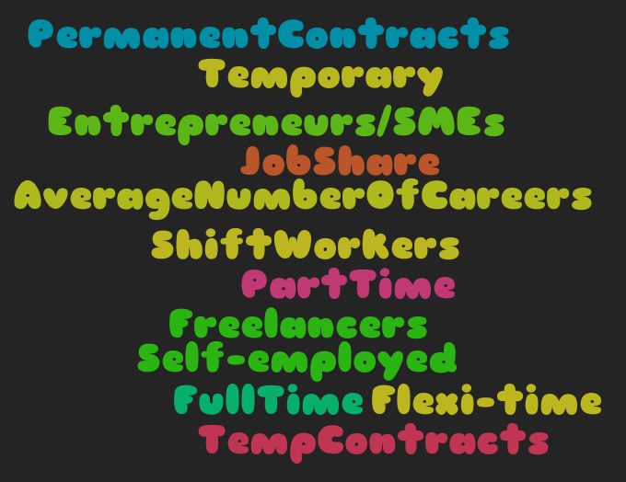
How many did you get right?
10?
8-9?
6-7?
5 or under
CONGRATULATIONS!

Slide 15
Work styles
Rank under three headings:
Would like Not sure Would not like
Independent
Seeking success
Hard working
Wide focus
Leading others
Being managed
Group work
Good work/life balance
Using your own ideas
Practical/physical
Theoretical
Explorative
Reflective
Analytical
Proactive
Narrow focus
Target driven
Long hours

Slide 16
Workplace
Rank under three headings:
Would like Not sure Would not like
Physically active work
Working outdoors
Working indoors
Dealing with the public
At home
In an office or company premises
On site or at a clients premises
Desk based
Various locations
In a modern building/office

Slide 17
Further task
Which different types of employment, work styles and workplace can apply to these roles:
Doctor
Hairdresser
Lawyer
Teacher
Accountant
Police officer
Vet
Engineer
Nurse
Designer
Business manager
Research scientist
Performing arts
Motor mechanic
Games designer/developer
Bricklayer

