Slide 1
Apprenticeships

Slide 2
Apprenticeship levels
Graduate level apprenticeships - available to SCQF level 11/master’s degree
Modern apprenticeships - available from SCQF level 5 up to degree level
Foundation apprenticeships - taken alongside Highers and National 5s, usually starting in S5

Slide 3
Case studies
Jane is a student studying Highers at school in Perth. Her subjects include maths, chemistry and physics. She would like an engineering career and has decided to achieve this through an apprenticeship.
Sam is studying for his National 5s in Edinburgh, and is on target to achieve six passes, including maths and English. He has recently done some work experience in a nursery and would like a career working with children. He doesn’t want to do Highers, but is keen to enter the workplace.
Visit apprenticeships.scot/find-a-vacancy to support your research
Choose one apprenticeship your case study student could apply for
What level apprenticeship is it?
What are the entry requirements?
What qualification and experience will they gain?
How much will they earn?
How far from home is the apprenticeship?
What is the application deadline?

Slide 4
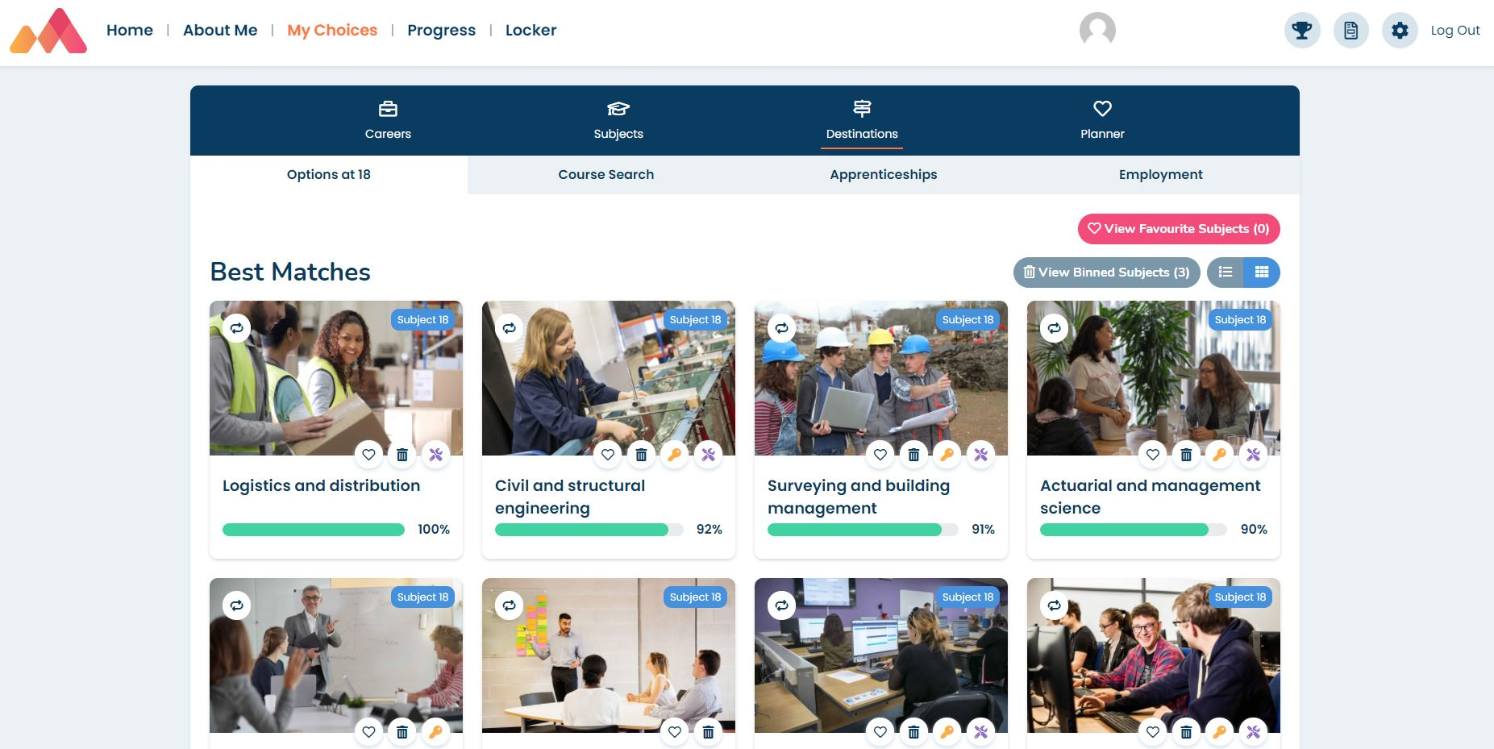
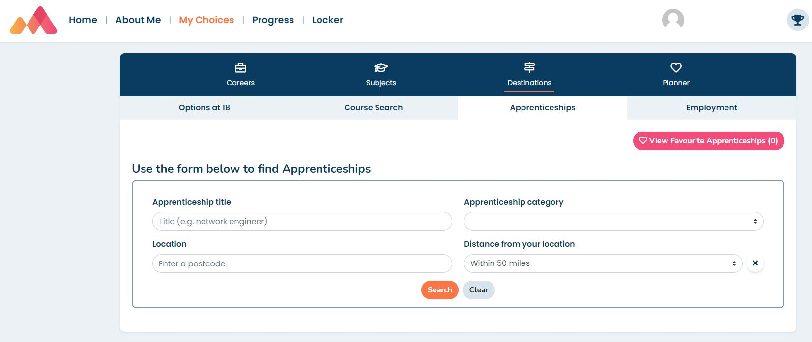
Apprenticeships on Morrisby
www.morrisby.com > Login
In your
My Choices > Destinations > Options at 18 area
In your My Choices > Destinations area
Click on a suggested subject tile to find out more about the apprenticeship

