Slide 1
Completing apprenticeship and job application forms

Slide 2
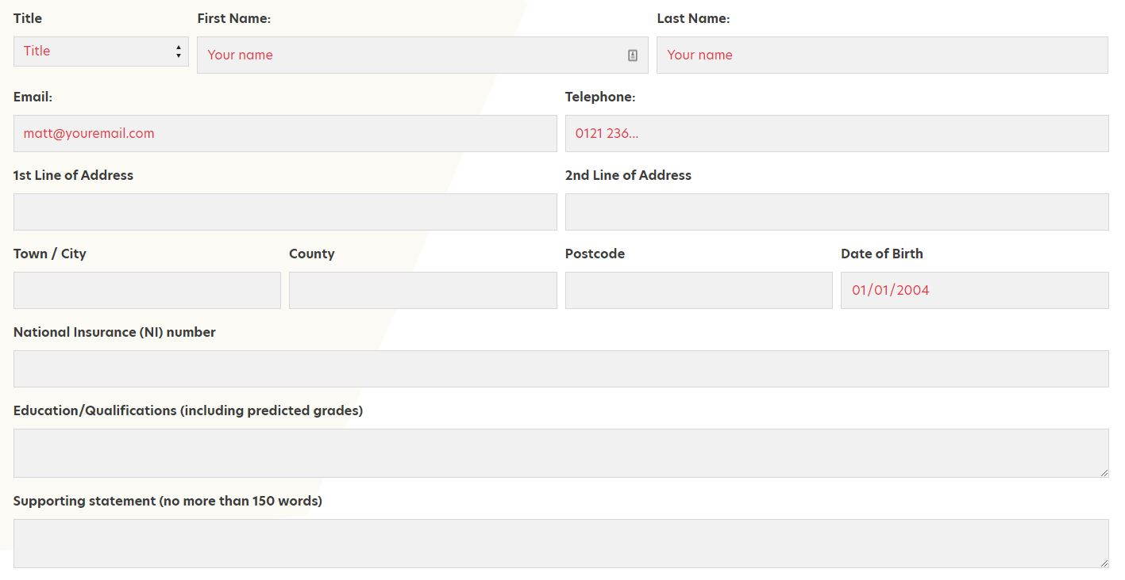
What is an application form?
A screening process to find candidates employers would like to invite to interview
A way for employers to get to know you better
A series of questions about you, your skills and motivations

Slide 3
What you can do to write a great application form…
Discuss in twos how you would go about doing these things…
How would you…?
Research the employer thoroughly
Understand the role fully
Decide on your skills
Draft your answers to questions
Plan your time
Check your spelling and grammar
Apply before the closing date

Slide 4
Basic details
Name
DOB
Address
Contact email and telephone number
National Insurance number
Education
Work experience / Voluntary experience / Positions of responsibility

Slide 5
Skills
Give an example of when you have used your listening skills…
Situation
As part of my volunteering, I worked at Hackney Children’s Home and often had to deal with angry parents who wanted access to their children which was not authorised.
Task
I regularly answered the phone and one day a particularly hostile father called and shouted at me when I told him that he could only visit his son on the next scheduled time which was 3 weeks away.
Action
I explained the rules to the gentleman and managed to stay calm, repeating the clear legislation. I realised that while his anger was directed at me, it was not personal, and that he was probably genuinely sad and worried about his child. I encouraged him to speak and tried to listen sympathetically to his concerns, then did my best to reassure him that his child was happy and healthy and being well cared for.
Result
I was able to calm the gentlemen down and we talked about when he would be able to visit and how nice it would be for both him and his son.
Questions about your skills
Consider your work experience, positions of responsibility, jobs, voluntary experience, DofE, etc
What skills have you used
Specific examples
Use:
Situation (10%)
Task (10%)
Action (70%)
Result (10%)

Slide 6
Task
Give an example of a time you worked well in a team
Situation (10%)
Task (10%)
Action (70%)
Result (10%)
Work in pairs

Slide 7
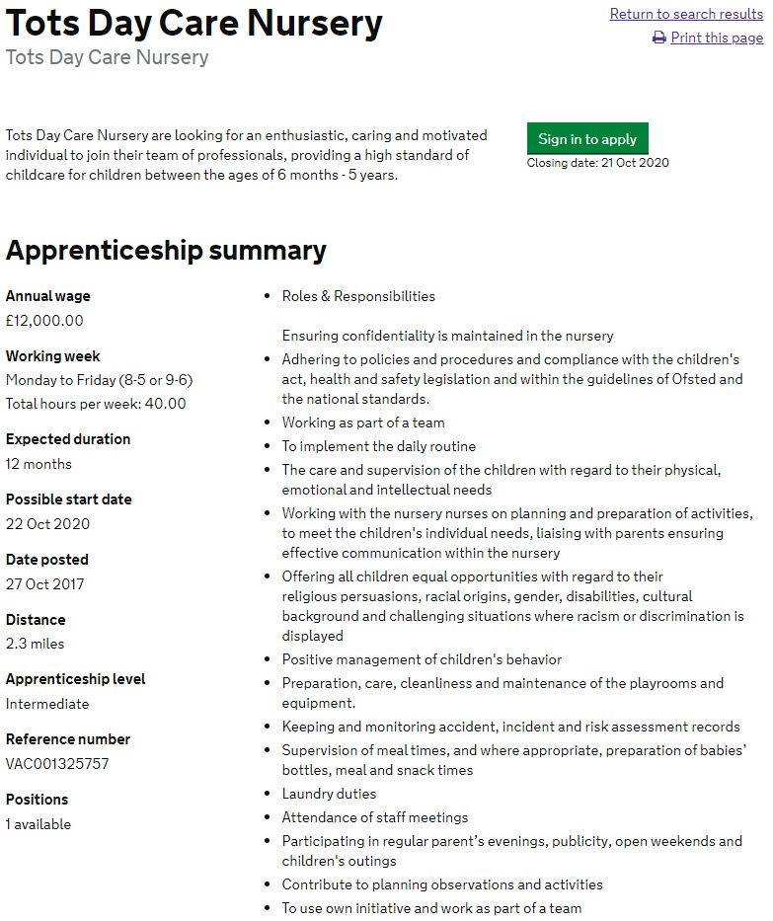
Supporting statement
Why you are applying for the job
Why you’d like to work for the employer
Use job description to underline skills the employer seeks
Include two or three examples of where you’ve used these skills
Briefly mention your hobbies and interests
Check word count and any guidance notes

Slide 8
Example supporting statement
Since working alongside a relative at the private nursery she works at, I have been interested in the development of the under 5s. I was particularly taken by one child who spent ten minutes trying to thread a bead onto a piece of string, and was thrilled when she succeeded. This cemented my enthusiasm for working with children. I was particularly interested to see the Tots Day Care Nursery website discuss the development of children and their staff, which made me decide to apply to this setting.
I am a natural team player, having recently obtained my silver Duke of Edinburgh. This involved a group trek where I supported one group member who was struggling. I motivated and encouraged them and enlisted the rest of the team to do the same. It was great fun and we all finished the trek together.
Similarly, I communicated with paresnts in the private nursery when they came to collece their children… (more).
Alongside walking, I am artistic and creative and also really enjoy knitting and creating fun patterns. I recently won the school prize for Art and feeling I could bring my creativity to working with children.
What does this statement do well?
What is not so strong?

