Slide 1
Morrisby Careers
Aspirations assessment session

Slide 2
What is involved
Open a browser, go to www.morrisby.com & click “SIGN UP”.

Slide 3
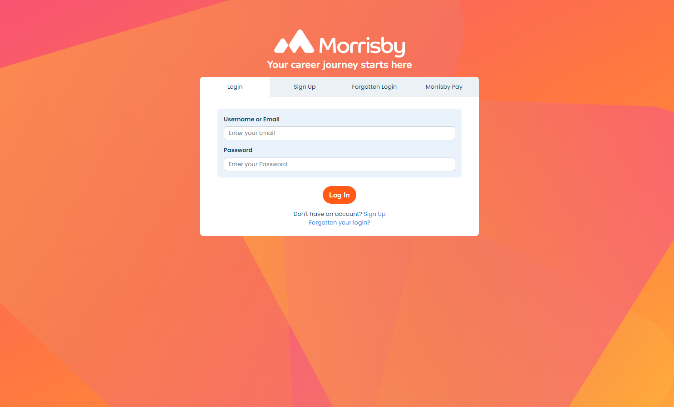

Slide 4
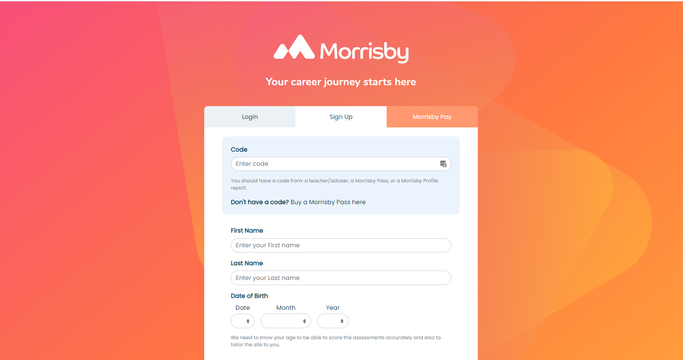

Slide 6
How should students approach it?
The process will take about 15-20 minutes.
The validity of the results, and therefore the value they will be later, will be impacted by the approach they take. So...
It is important to be honest in answering the questions
Make sure your answers are based on your own interests and not on what you think you should be answering
Although the questionnaire is untimed, don’t take too long on each question - just answer with the first thing that comes into your head as this is usually the most accurate answer
If your interests change in the future you can retake the questionnaire
Your results will include a number of careers that best match your interests

Slide 7
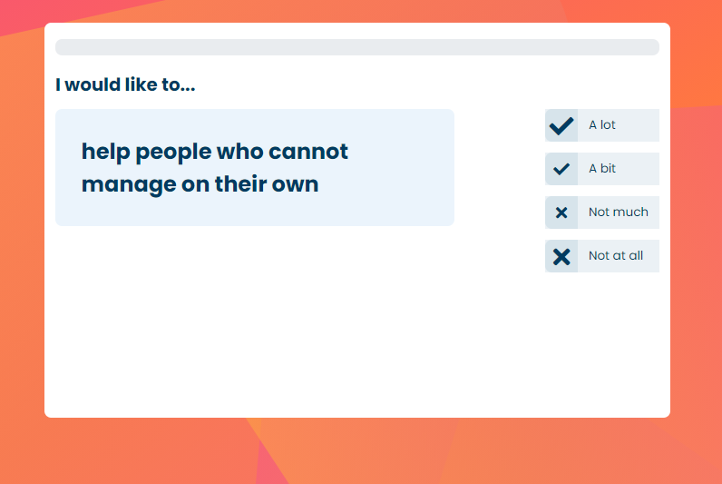
The Aspirations questionnaire

Slide 8
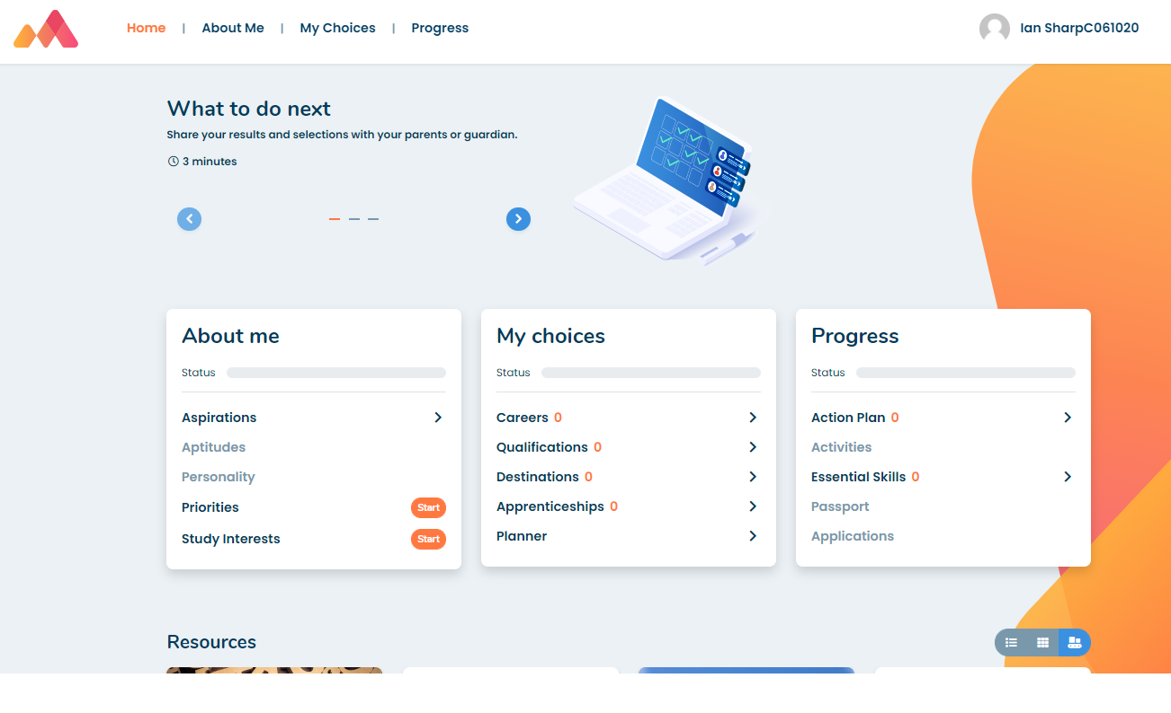
Dashboard / Homepage > Select Aspirations

Slide 9
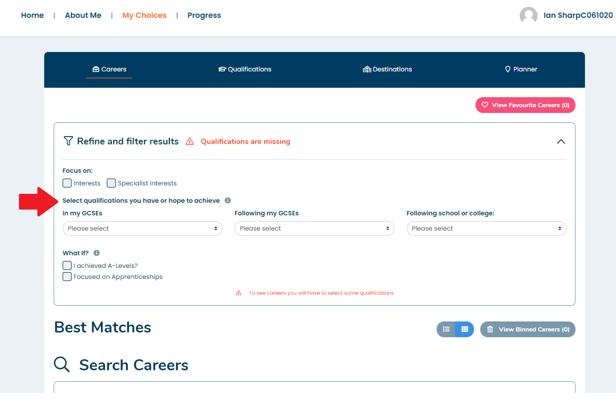
Set qualification levels to view suggestions…

Slide 10
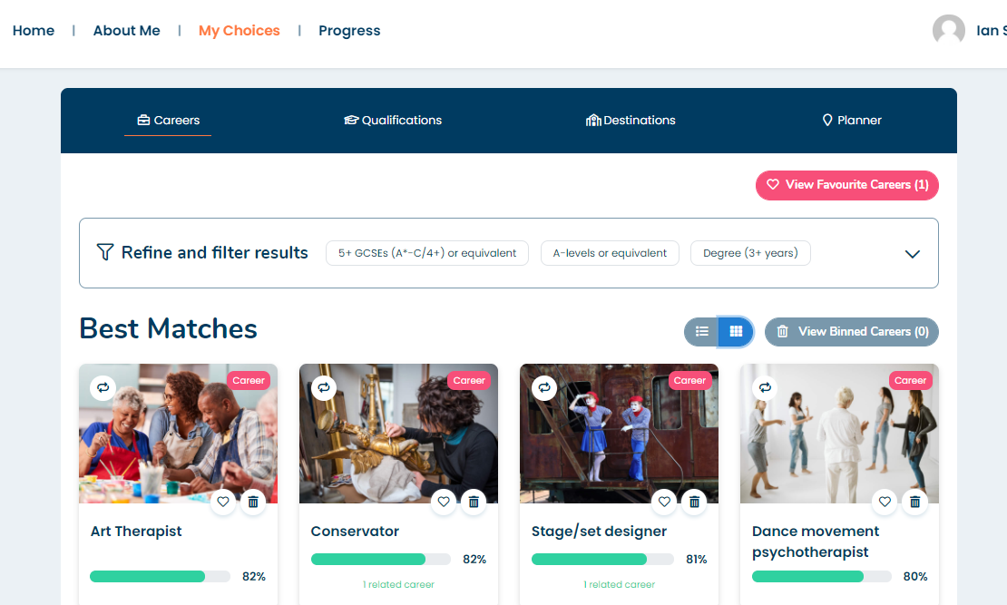
Start researching Careers!

