Slide 1
Options at 16

Slide 2
Lesson objectives
Explain your range of options at 16
Understand how your learning style is relevant to decisions at 16
Discuss how your preferred career option and routes to get there may affect your decision at 16
Consider entry requirements for education and apprenticeships beyond age 16

Slide 3
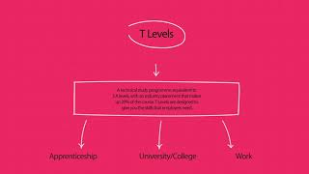
Video - England

Slide 4
Video - Wales

